Slide 1
Shade Trees and their Management in Coffee
ADB TA 6898-REG: (IND) Climate-Resilient Farmer Group Development to Support Covid-19 Recovery for Smallholder Coffee Farmers

Slide 2
Contents
Shade in coffee
Importance in climate resilient coffee farming
Advantages & disadvantages
Desirable features shade trees & Suitable types of shade trees
Planting & management of shade trees
Pest & Diseases in shaded coffee & their management

Slide 3
Shade in coffee

Slide 4
Importance of shade in climate resilient coffee farming
Coffee is a shade loving plant
Mostly grown under shade worldwide except in countries like Brazil, Vietnam etc.
Shade protects coffee from vagaries of weather
Commercialization of production led to reduction of shade cover
Climate change is affecting coffee production world over
Shade is an important tool to mitigate the effects of climate change.
Notes:
Coffee is shade loving plant. It can not withstand excess heat and prolonged dry or cold conditions.
World over coffee is grown under natural shade canopy to a varying degree, except in few countries like Brazil, Vietnam etc.
Shade gives protection to coffee from vagaries of weather like high temp., heavy rains, hail storms and drought etc.
Over the years, shade cover was either reduced or completely removed in many countries, to increase productivity.
Climate change is causing extreme weather conditions like increased heat, frequent drought and abnormally heavy rainfall adversely affecting coffee production.
Shade is an important tool to mitigate the effects of climate change.

Slide 5
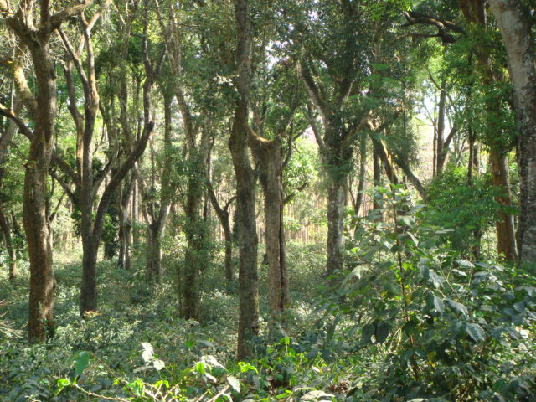
Image courtesy: Coffee Board of India
Notes:
A well maintained two-tier shade canopy in Arabica plantation in India
Elevation: 900-1200 meter MSL

Slide 6
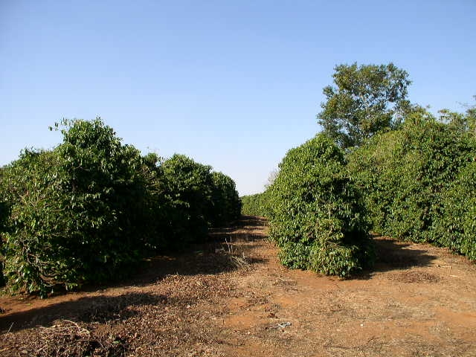
Photo by Dr Raghuramulu
Notes:
Coffee grown without shade in Brazil
Elevation: 900-1200 metres

Slide 7
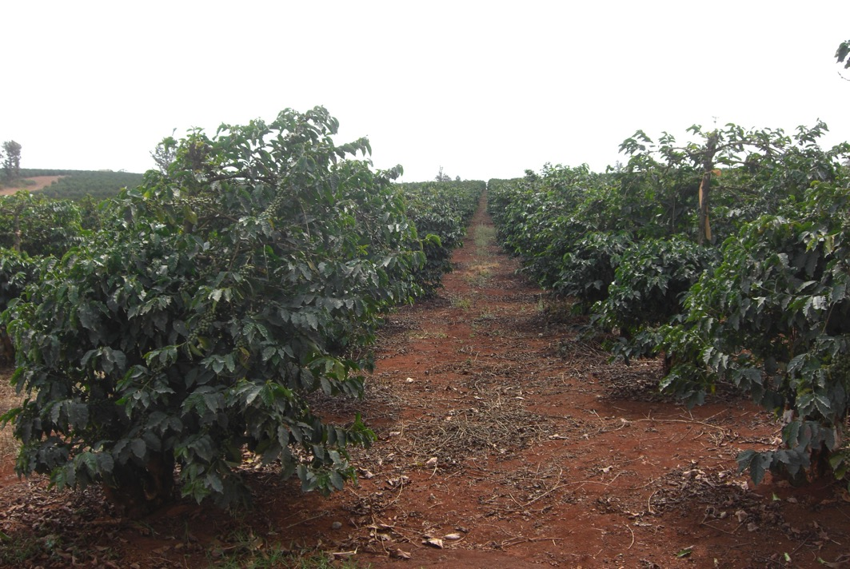
Photo by Dr Raghuramulu
Notes:
Coffee grown in open conditions in Kenya
Elevation: 1200 to >1700 meters MSL

Slide 8
Photos by Dr Raghuramulu
Notes:
Coffee in Indonesia – with or without shade
Elevation: 1100-1600 meter MSL

Slide 9
Advantages of shade trees
Protects coffee from harsh climatic conditions
Prevent overbearing and exhaustion - sustainable yields
Bold & high quality beans
Improve soil organic matter & recycling of nutrients - reduction of fertilizers
As supports for black pepper vines
Additional income from firewood and timber
Important tool in IPDM
Shelter for flora and fauna & natural enemies of pests
Carbon sink
Notes:
Protects coffee from harsh climatic conditions like high temperature, drought, heavy rains and hailstorms
Prevent overbearing and exhaustion of coffee plants - sustainable yields
Shade grown coffee produces bold & high quality beans
Adds leaf litter - improve soil organic matter, recycling of nutrients from deeper layers leading to reduction of chemical fertilizers
Used as standards (support) for growing black pepper vines
Provide additional income from firewood and timber
Help in better management of some pests & diseases like stem borer & leaf rust in Arabica and sucking pests
Provide shelter for flora and fauna as well as natural enemies of pests
Shade trees act as Carbon sink & thereby reduce the major green house gas viz., CO₂

Slide 10
Disadvantages of shade trees
Less yield compared to coffee grown in open conditions
May increase certain pests and diseases under too much shade
Adds to cost of production by way of regular shade pruning
Notes:
Reduction in yield by up to 20% when compared to coffee grown in open conditions
May increase certain pests and diseases like shoot borer, anthracnose etc. if excess shade is maintained
Adds to cost of production by way of regular shade pruning

Slide 11
Shade vs No Shade
Shade coffee | Parameter | Open cultivation
20-30% less | Yield | High yield
High | Quality | Low
~ 35-40 years | Replanting cycle | ~ 15-20 years
Very good | Soil Health | Poor
Low to medium | Agrochemical use | High
Tolerant | Heat, Drought & Hail storm | Susceptible
Low risk | Pests & Diseases | High risk
Yes | Additional income | No
Yes | Additional cost of management | No

Slide 12
Desirable features shade trees & Suitable types of shade trees

Slide 13
An Ideal
Shade Tree
Evergreen
Small leaves
Spreading type branching
Strong branches
^{X} Do not compete with coffee
^{X} Do not act as alternate host
Strong, deep root system
Notes:
The trees selected for providing shade cover to coffee should
Be evergreen and have fast growth habit
Have spreading type growth habit
Have deep root system, strong branches and withstand heavy winds
Have smaller leaves and provide filtered shade
Not compete with coffee for soil moisture and nutrients
Not be alternate hosts for pests and diseases affecting coffee

Slide 14
Suitable types of shade trees
Temporary Shade trees – fast growing trees to protect young coffee
Erythrina lithosperma
Glyricidia sp.
Short duration fruit plants like Banana, Papaya etc.
Permanent shade trees -
Ficus sp.
Albizzia sp.
Fruit trees like Avocado, Mango, Jackfruit, Sapodilla, Java Plum (Syzygium cumini) etc.

Slide 15
Planting & management of shade trees

Slide 16
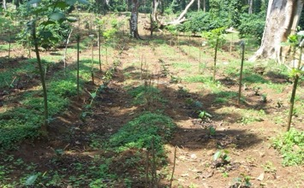
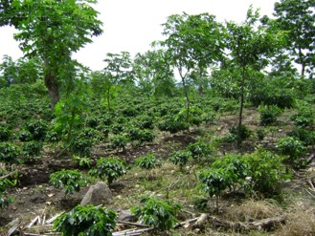
Planting of shade trees
While clearing new areas for coffee planting, retain native evergreen trees
Plant Temporary shade trees at close spacing (15-20 feet apart) alongwith coffee
Plant permanent shade trees at wider spacing (30-40 feet apart) anytime during the first 2-3 years of coffee planting
Images courtesy: Coffee Board of India

Slide 17
C |  | C |  | C |  | C |  | C |  | C |  | C |  | C |  | C |  | C
 | S |  |  |  | F |  |  |  | S |  |  |  | F |  |  |  | S
C |  | C |  | C |  | C |  | C |  | C |  | C |  | C |  | C |  | C
C |  | C |  | C |  | C |  | C |  | C |  | C |  | C |  | C |  | C
 | F |  |  |  | F |  |  |  | F |  |  |  | F |  |  |  | F
C |  | C |  | C |  | C |  | C |  | C |  | C |  | C |  | C |  | C
C |  | C |  | C |  | C |  | C |  | C |  | C |  | C |  | C |  | C
 | S |  |  |  | F |  |  |  | S |  |  |  | F |  |  |  | S
C |  | C |  | C |  | C |  | C |  | C |  | C |  | C |  | C |  | C
C |  | C |  | C |  | C |  | C |  | C |  | C |  | C |  | C |  | C
 | F |  |  |  | F |  |  |  | F |  |  |  | F |  |  |  | F
C |  | C |  | C |  | C |  | C |  | C |  | C |  | C |  | C |  | C
C |  | C |  | C |  | C |  | C |  | C |  | C |  | C |  | C |  | C
 | S |  |  |  | F |  |  |  | S |  |  |  | F |  |  |  | S
A Model Planting Design for Shade trees
C – Coffee 10x10ft
TS – Temp shade trees 20x20ft
PS – Permanent Shade Trees 40x40ft

Slide 18
Pruning of Temporary Shade Trees
Temporary shade canopy should be maintained at 10-12 feet from ground level.
Each year, all the branches should be cut back after commencement of rainy season.
Towards the end of rainy season, the emerging new branches should be regulated by retaining 3-4 branches in all directions to provide umbrella shade
Image courtesy: Coffee Board of India

Slide 19
Pruning of Permanent Shade Trees
Height should be maintained at about 30 feet from ground level
Lower hanging branches on main trunk to be removed regularly
Once in 2-3 years, top branches should be thinned out just prior to onset of rainy season to provide filtered shade to coffee bushes
Image courtesy: Coffee Board of India

Slide 20
Criteria for shade intensity
Arabica – requires medium to good shade cover to provide 50% sunlight (55000 to 70000 LUX)
Robusta – requires less shade to provide 70% sunlight (70000 to 90000 LUX)
High elevation (1000m & above) – reduce shade cover
Low elevation (<900m), western aspect – increase shade cover
Irrigated coffee – less shade cover
Rainfed coffee – more shade cover

Slide 21
Pest & Diseases in shaded coffee & their management

Slide 22
Branch/ twig borer (Xylosandrus compactus Eichhoff)
Beetles make a hole and a small tunnel on new branches leading to drying of branches
Infestation seen after rainy season (Oct-Dec)
Flares up in heavily shaded and poorly drained conditions
Management includes reduction of shade cover and Nitrogen fertilizer, pruning and burning of affected branches during the season and regular removal of suckers
Image courtesy: CABI Plantwise

Slide 23
Anthracnose (Colletotrichum gleosporioides Penz)
Usually leads to rotting of berries and leaves during rainy season
Disease increases in heavily shaded and poorly drained conditions
Management includes; reduction of shade, improving drainage, removal and spraying of 0.5% Bordeaux mixture or copper based fungicides before rainy season
When disease is in the initial stages, remove and burn diseased leaves and berries, and spray carbendazim @ 0.6g per litre of water
Image courtesy: WASI, Vietnam

Slide 24
Terima kasih

